Slide 1


Y6 SATS 2022

Slide 2

What are the SATS tests?
The end of KS2 assessments are sometimes informally referred to as ‘SATs’.
SATs week across the country begins on 9th May 2022.
Pupils will complete SATS test papers in:
- Grammar, Punctuation & Vocabulary
- Spelling
- Reading
- Arithmetic
- Mathematical Reasoning – 3 papers
Other areas, like writing, are assessed using evidence collected by the teacher over a longer period of time
.

Slide 3
How do the tests take place?
The tests all take place in normal school time, under test conditions.
The completed papers are sent away to be marked externally.
Results are returned to school in July.
The tests vary in length but last no longer than 60 minutes:
- Reading: 60 minutes
- Grammar, Punctuation & Vocabulary: 45 minutes
- Spelling: 15-20 minutes
- Arithmetic: 30 minutes
- Mathematical Reasoning: 2 papers of 40 minutes each.

Slide 4
How are the tests graded?
The marked tests will provide the following information:
- A raw score (i.e. number of marks)
- A scaled score (see below)
- An indication of whether the national standard has been met.
In scaled scores, a score of 100 represents the national standard. The lowest is 80 and the highest is 120.
After each test is marked, it will be converted into a scaled score
A pupil will need to achieve a scaled score of 100 to show that they have met the national standard on the test.
There are no longer separate tests for higher attaining pupils, a scaled score of closer to 120 which would indicate the pupil is working above the expected standard.

Slide 5
The Reading Test
Pupils will have 60 minutes to complete the test, including reading the texts and writing the answers.
The test will have three different texts to read, drawing on fiction, non-fiction or poetry.
Questions are focused around the following areas (called ‘content domains’):
- give/explain the meaning of words in context
- retrieve and record information/identify key details from fiction and non-fiction
- summarise main ideas from more than one paragraph
- make inferences from the text/explain and justify inferences with evidence from the text
- predict what might happen from details stated and implied
- identify/explain how information/narrative content is related and contributes to
meaning as a whole
- identify/explain how meaning is enhanced through choice of words and phrases
- make comparisons within the text
There are a range of answer types, including multiple choice, short one-word answers and longer answers that require a written paragraph.

Slide 6
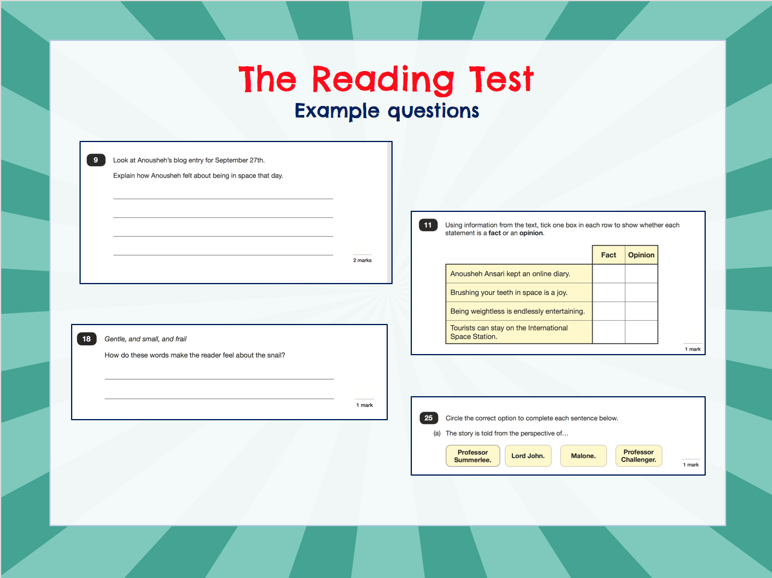
©Ks2history 2018

Slide 7
The SPaG Tests
There are two tests: a short spelling test – 15/20 minutes and a longer paper testing grammar, punctuation and vocabulary – 45 minutes.
Questions in the grammar test are focused around the following areas (called ‘content domains’):
- Grammatical terms/word classes
- Functions of sentences
- Combining words, phrases and clauses
- Verb forms, tenses and consistency
- Punctuation
- Vocabulary
- Standard English and formality
There are a range of answer types in the grammar test, including multiple choice and short one-word answers, but there will not be any long written answers required

Slide 8
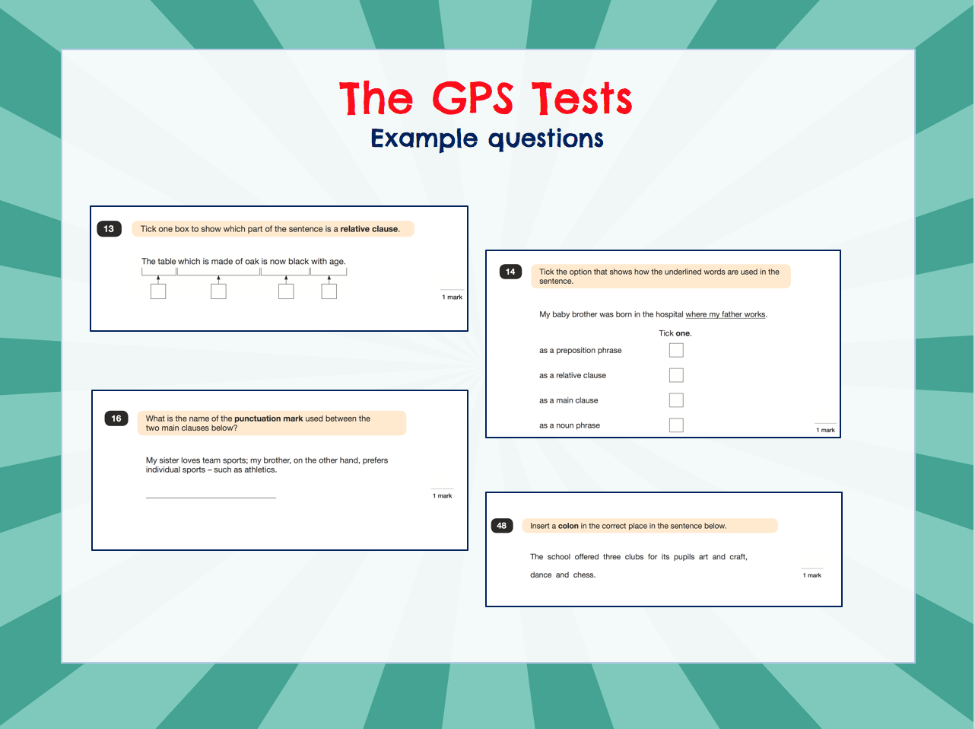
©Ks2history 2018

Slide 9
The Maths Tests
There are three tests: one arithmetic paper and two reasoning papers.
Paper 1 (arithmetic) lasts 30 minutes and assesses pupils’ confidence using methods of calculation as well as fractions, decimals and percentages.
Papers 2 & 3 (reasoning) last 40 minutes each and focus on problem solving, fluency and applying mathematical reasoning.
Questions cover the following areas (called ‘content domains’):
- Number and place value
- Addition, subtraction, multiplication and division (calculations)
- Geometry – properties of shapes
- Geometry – position and direction
- Statistics
- Measurement
- Algebra
- Ratio and proportion
- Fractions, decimals and percentages.

Slide 10
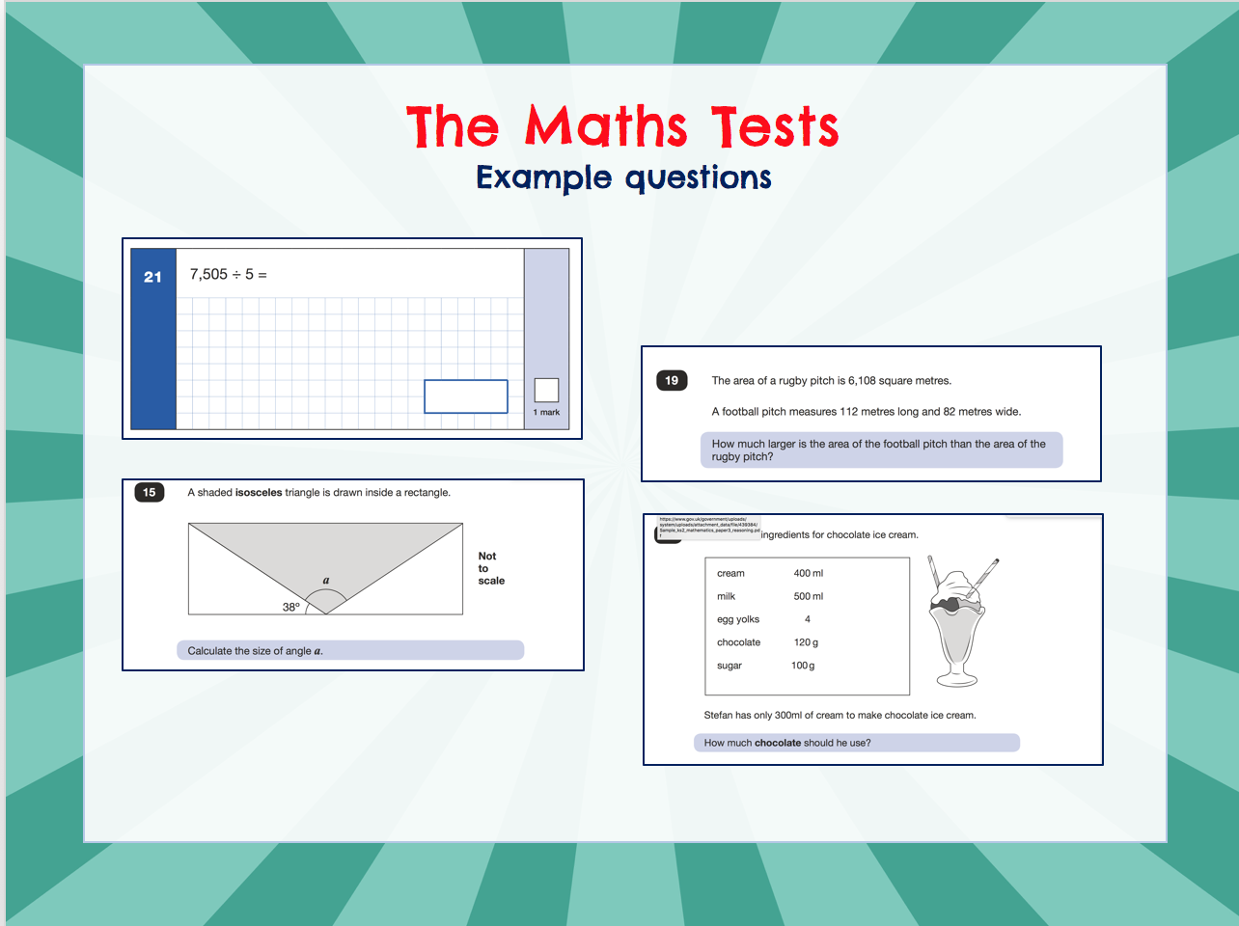
©Ks2history 2018

Slide 11
Other Assessments
Writing assessments will be formed from judgements made by the teacher, looking at evidence from writing collected over the course of the year.
The teacher will moderate their assessments with other professionals to make sure there is a consistent standard across the country.
Final judgements will be reported to parents at the same time as the other assessment results.

Slide 12
How can I help my child?
Help children not to feel worried or pressured about SATS
Do give lots of praise, encouragement and reassurance!
Help children with organising their homework and support their reading for pleasure activities.
Help them to have early nights and a healthy diet.
Help your child to have the best possible attendance at school.
Remind them that they have taken part in lots of similar assessments and that doing their best is all that is expected.
Please speak to a member of staff if you have questions or concerns.

Slide 13

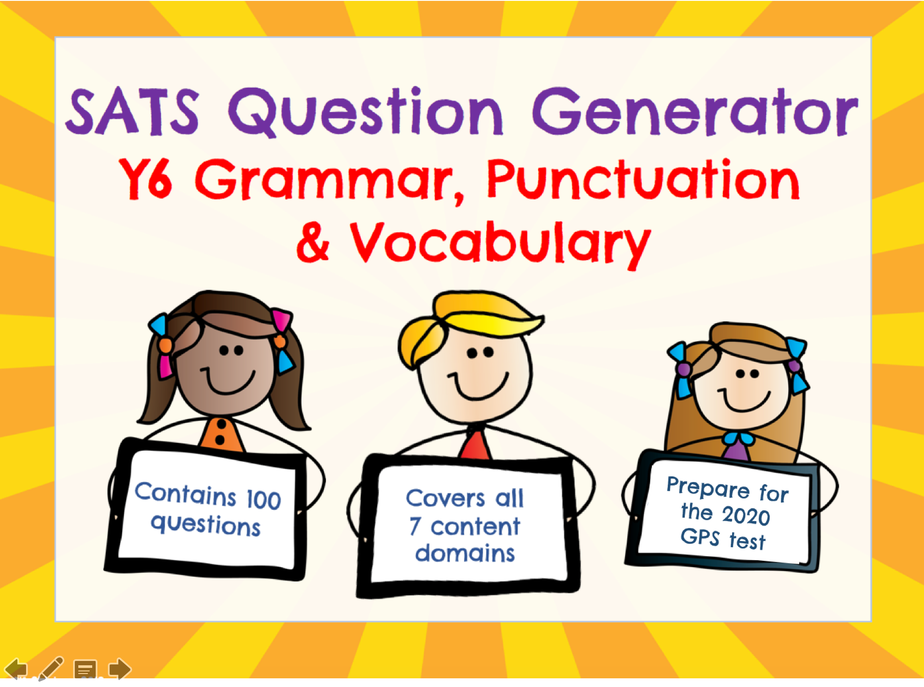
Y6 SPAG Question Generator
https://www.tes.com/teaching-resource/ks2-sats-y6-spag-revision-gps-11835425
Y6 Reading Question Generator
https://www.tes.com/teaching-resource/y6-reading-ks2-sats-revision-11818839

